Slide 1



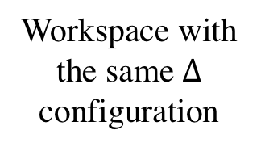

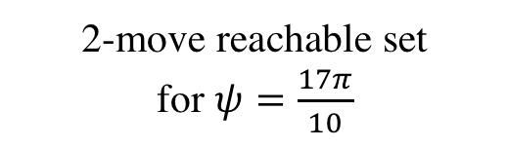








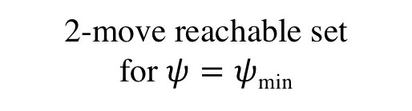

$$ψ$$
l₄
s
c
$$γ$$
$ψ$_{min}
$$d_{⊥}$$
c
$ψ$_{max}-2$π$
g
$$d_{12}$$
$$θ$$
l₁
l₃
l₂
Workspace with the same$∆$ configuration
$$ψ$$
$$ψ$$
c
c
$$γ$$
$$γ$$
$$d_{⊥}$$
$$d_{⊥}$$
2-move reachable set
for $ψ=ψ$_{min}
2-move reachable set
for $ψ=\frac{17π}{10}$

